Slide 1

Stage 7
Wish You Weren't So Awkward, Bud
Course Designer: Eric Beerbaum
Wish You Weren't So Awkward, Bud is a 22 round, 110 point Comstock medium course. There are 11 USPSA targets. The best two hits per target will score. The start signal is audible
The Handgun start position is inside box A, facing downrange, handgun loaded and holstered, wrists below belt.
The PCC start position is is standing in box A, facing downrange, PCC loaded, stock on belt, muzzle generally downrange.
On the audible start signal, engage targets as they become visible.
Notes:
‹#›

Slide 2
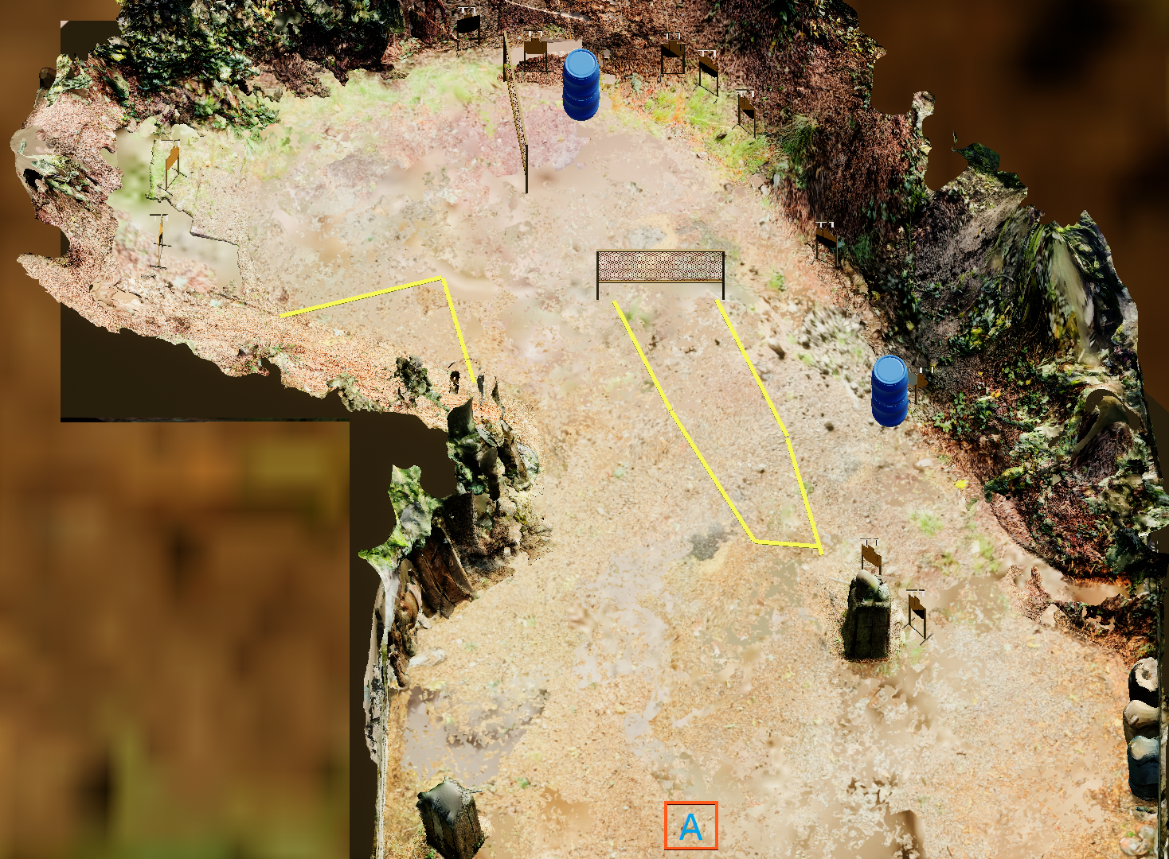
Stage 7
Wish You Weren't So Awkward, Bud
Course Designer: Eric Beerbaum

